Slide 1
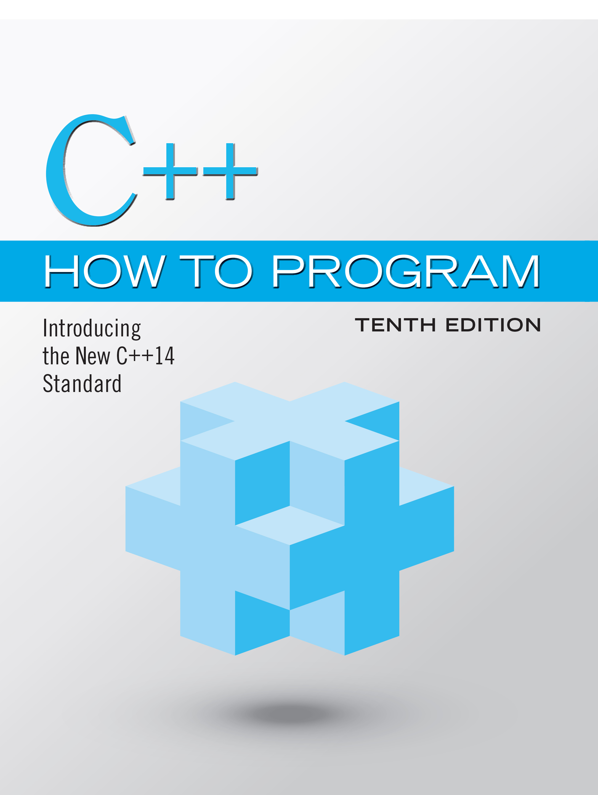
C++ How to Program: Introducing the New C++14 Standard
Tenth Edition
Chapter 4
Algorithm Development and Control Statements: Part 1
Slides in this presentation contain hyperlinks. JAWS users should be able to get a list of links by using INSERT+F7
Copyright © 2017, 2014, 2012 Pearson Education, Inc. All Rights Reserved
Notes:
If this PowerPoint presentation contains mathematical equations, you may need to check that your computer has the following installed:
1) MathType Plugin
2) Math Player (free versions available)
3) NVDA Reader (free versions available)

Slide 2
Learning Objectives (1 of 2)
In this chapter you’ll:
Learn basic problem-solving techniques.
Develop algorithms through the process of top-down, stepwise refinement.
Use the if and if…else selection statements to choose between alternative actions.
Use the while iteration statement to execute statements in a program repeatedly.
Use counter-controlled iteration and sentinelcontrolled iteration.

Slide 3
Learning Objectives (2 of 2)
Use nested control statements.
Use the compound assignment operator and the increment and decrement operators.
Learn about the portability of fundamental data types.

Slide 4
Outline (1 of 6)
4.1 Introduction
4.2 Algorithms
4.3 Pseudocode
4.4 Control Structures
4.4.1 Sequence Structure
4.4.2 Selection Statements
4.4.3 Iteration Statements
4.4.4 Summary of Control Statements

Slide 5
Outline (2 of 6)
4.5 if Single-Selection Statement
4.6 if…else Double-Selection Statement
4.6.1 Nested if…else Statements
4.6.2 Dangling-else Problem
4.6.3 Blocks
4.6.4 Conditional Operator (?:)
4.7 Student Class: Nested if…else Statements
4.8 while Iteration Statement

Slide 6
Outline (3 of 6)
4.9 Formulating Algorithms: Counter- Controlled Iteration
4.9.1 Pseudocode Algorithm with Counter- Controlled Iteration
4.9.2 Implementing Counter-Controlled Iteration
4.9.3 Notes on Integer Division and Truncation
4.9.4 Arithmetic Overflow
4.9.5 Input Validation

Slide 7
Outline (4 of 6)
4.10 Formulating Algorithms: Sentinel- Controlled Iteration
4.10.1 Top-Down, Stepwise Refinement: The Top and First Refinement
4.10.2 Proceeding to the Second Refinement
4.10.3 Implementing Sentinel-Controlled Iteration
4.10.4 Converting Between Fundamental Types Explicitly and Implicitly
4.10.5 Formatting Floating-Point Numbers
4.10.6 Unsigned Integers and User Input

Slide 8
Outline (5 of 6)
4.11 Formulating Algorithms: Nested Control Statements
4.11.1 Problem Statement
4.11.2 Top-Down, Stepwise Refinement: Pseudocode Representation of the Top
4.11.3 Top-Down, Stepwise Refinement: First Refinement
4.11.4 Top-Down, Stepwise Refinement: Second Refinement
4.11.5 Complete Second Refinement of the Pseudocode

Slide 9
Outline (6 of 6)
4.11.6 Program That Implements the Pseudocode Algorithm
4.11.7 Preventing Narrowing Conversions with List Initialization
4.12 Compound Assignment Operators
4.13 Increment and Decrement Operators
4.14 Fundamental Types Are Not Portable
4.15 Wrap-Up

Slide 10
4.1 Introduction
Before writing a program to solve a problem, have a thorough understanding of the problem and a carefully planned approach to solving it.
Understand the available building blocks and employ proven program-construction techniques.

Slide 11
4.2 Algorithms
Any solvable computing problem can be solved by the execution a series of actions in a specific order.
An algorithm is a procedure for solving a problem in terms of
the actions to execute and
the order in which these actions execute
Specifying the order in which statements (actions) execute in a computer program is called program control.
This chapter investigates program control using C++’s control statements.

Slide 12
4.3 Pseudocode (1 of 2)
Pseudocode (or “fake” code) is an artificial and informal language that helps you develop algorithms.
Similar to everyday English
Convenient and user friendly.
Helps you “think out” a program before attempting to write it.
Carefully prepared pseudocode can easily be converted to structured portions of C++ programs.

Slide 13
4.3 Pseudocode (2 of 2)
Normally describes only executable statements.
Declarations (that do not have initializers or do not involve constructor calls) are not executable statements.
Figure 4.1 corresponds to the algorithm that inputs two integers from the user, adds these integers and displays their sum.

Slide 14
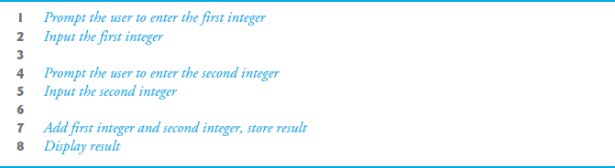
Figure 4.1 Pseudocode for the Addition Program of Figure 2.5

Slide 15
4.4 Control Structures (1 of 2)
Normally, statements in a program are executed one after the other in the order in which they’re written.
Called sequential execution.
Various C++ statements enable you to specify that the next statement to execute may be other than the next one in sequence.
Called transfer of control.

Slide 16
4.4 Control Structures (2 of 2)
All programs could be written in terms of only three control structures
the sequence structure
the selection structure and
the iteration structure
When we introduce C++’s implementations of control structures, we’ll refer to them in the terminology of the C++ standard document as “control statements.”

Slide 17
4.4.1 Sequence Structure (1 of 5)
Unless directed otherwise, the computer executes C++ statements one after the other in the order in which they’re written—that is, in sequence.
The Unified Modeling Language (U M L) activity diagram of Figure 4.2 illustrates a typical sequence structure in which two calculations are performed in order.
C++ lets you have as many actions as you want in a sequence structure.
Anywhere a single action may be placed, we may place several actions in sequence.

Slide 18
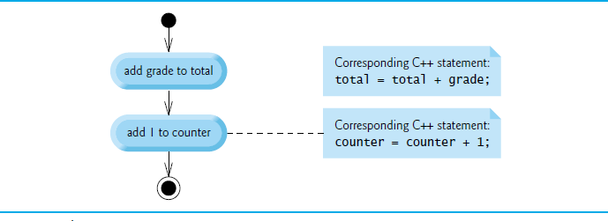
Figure 4.2 Sequence-Structure Activity Diagram

Slide 19
4.4.1 Sequence Structure (2 of 5)
An activity diagram models the workflow (also called the activity) of a portion of a software system.
Such workflows may include a portion of an algorithm, such as the sequence structure in Figure 4.2.
Activity diagrams are composed of special-purpose symbols, such as action state symbols (rectangles with their left and right sides replaced with arcs curving outward), diamonds and small circles; these symbols are connected by transition arrows, which represent the flow of the activity.

Slide 20
4.4.1 Sequence Structure (3 of 5)
Activity diagrams help you develop and represent algorithms, but many programmers prefer pseudocode.
Activity diagrams clearly show how control structures operate.
Action states represent actions to perform.
Each contains an action expression that specifies a particular action to perform.

Slide 21
4.4.1 Sequence Structure (4 of 5)
The arrows in the activity diagram are called transition arrows.
Represent transitions, which indicate the order in which the actions represented by the action states occur.
The solid circle at the top of the diagram represents the activity’s initial- state—the beginning of the workflow before the program performs the modeled activities.
The solid circle surrounded by a hollow circle that appears at the bottom of the activity diagram represents the final state—the end of the workflow after the program performs its activities.

Slide 22
4.4.1 Sequence Structure (5 of 5)
Rectangles with the upper-right corners folded over are called notes in the U M L.
Explanatory remarks that describe the purpose of symbols in the diagram.
Notes can be used in any U M L diagram.
Figure 4.2 uses U M L notes to show the C++ code associated with each action state in the activity diagram.
A dotted line connects each note with the element that the note describes.

Slide 23
4.4.2 Selection Statements (1 of 2)
C++ has three types of selection statements (discussed in this chapter and Chapter 5).
The if selection statement either performs (selects) an action (or group of actions) if a condition (predicate) is true or skips the action (or group of actions) if the condition is false.
The if…else selection statement performs an action (or group of actions) if a condition is true or performs a different action (or group of actions) if the condition is false.
The switch selection statement (Chapter 5) performs one of many different actions (or groups of actions), depending on the value of an integer expression.

Slide 24
4.4.2 Selection Statements (2 of 2)
The if selection statement is a single-selection statement because it selects or ignores a single action (or group of actions).
The if…else statement is called a double-selection statement because it selects between two different actions (or groups of actions).
The switch selection statement is called a multiple-selection statement because it selects among many different actions (or groups of actions).

Slide 25
4.4.3 Iteration Statements (1 of 2)
C++ provides three types of iteration statements (also called looping statements or loops) for performing statements repeatedly while a condition (called the loop-continuation condition) remains true—while, do…while and for.
The while and for statements perform the action (or group of actions) in their bodies zero or more times.
The do…while statement performs the action (or group of actions) in its body at least once.

Slide 26
4.4.3 Iteration Statements (2 of 2)
Each of the words if, else, switch, while, do and for is a C++ keyword.
These words are reserved by the C++ programming language to implement various features, such as C++’s control statements.
Keywords cannot be used as identifiers, such as variable names.
Figure 4.3 provides a complete list of C++ keywords-.

Slide 27
Figure 4.3 C++ keywords (1 of 2)
Keywords common to the C and C++ programming languages
asm | auto | break | case | char
const | continue | default | do | double
else | enum | extern | float | for
goto | if | inline | int | long
register | return | short | signed | sizeof
static | struct | switch | typedef | union
unsigned | void | volatile | while | Blank

Slide 28
Figure 4.3 C++ keywords (2 of 2)
C++-only keywords
and | and_eq | bitand | bitor | bool
catch | class | compl | const_cast | delete
dynamic_cast | explicit | export | false | friend
mutable | namespace | new | not | not_eq
operator | or | or_eq | private | protected
public | reinterpret_cast | static_cast | template | this
throw | true | try | typeid | Typename
using | virtual | wchar_t | xor | xor_eq

Slide 29
Figure 4.3 C++ keywords (3 of 3)
C++11 keywords
alignas | alignof | char16_t | char32_t | constexpr
decltype | noexcept | nullptr | static_assert | thread_local

Slide 30
4.4.4 Summary of Control Statements
Each program is formed by combining as many of each of these control statements as appropriate for the algorithm the program implements.
We can model each control statement as an activity diagram with initial and final states representing that control statement’s entry and exit points, respectively.
Single-entry/single-exit control statements
Connecting the exit point of one control statement to the entry point of the next.
Called control-statement stacking.
Only one other way to connect control statements—called control-statement nesting, in which one control statement is contained inside another.

Slide 31
4.5 If Single-Selection Statement
Programs use selection statements to choose among alternative courses of action.
Pseudocode to determine whether “student’s grade is greater than or equal to 60” is true
If student’s grade is greater than or equal to 60 Print “Passed”
If true, “Passed” is printed and the next pseudocode statement in order is “performed” (remember that pseudocode is not a real programming language).
If false, the print statement is ignored and the next pseudocode statement in order is performed.
The indentation of the second line is optional, but it’s recommended because it emphasizes the inherent structure of structured programs.

Slide 32
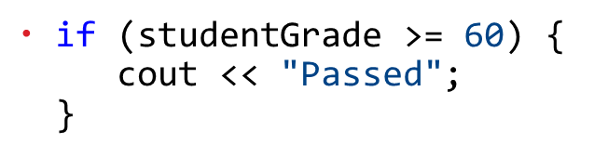
4.5 If Selection Statement (1 of 2)
The preceding pseudocode If statement can be written in C++ as
In C++, a decision can be based on any expression that evaluates to zero or nonzero
If the expression evaluates to zero, it’s treated as false; if the expression evaluates to nonzero, it’s treated as true.
C++ also provides the data type bool for Boolean variables that can hold only the values true and false.

Slide 33
Portability Tip 4.1
For compatibility with earlier versions of C, which used integers for Boolean values, the bool value true also can be represented by any nonzero value (compilers typically use 1) and the bool value false also can be represented as the value zero.

Slide 34
4.5 If Selection Statement (2 of 2)
Figure 4.4 illustrates the single-selection if statement.
The diamond or decision symbol indicates that a decision is to be made.
The workflow will continue along a path determined by the symbol’s associated guard conditions, which can be true or false.
Each transition arrow emerging from a decision symbol has a guard condition in square brackets above or next to the arrow.
If a guard condition is true, the workflow enters the action state to which that transition arrow points.

Slide 35
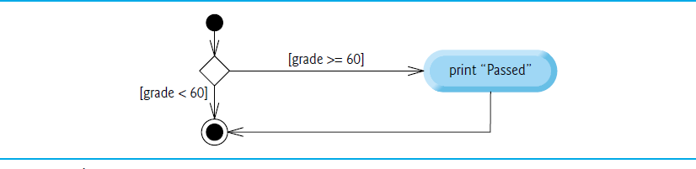
Figure 4.4 If Single-Selection Statement U M L Activity Diagram

Slide 36
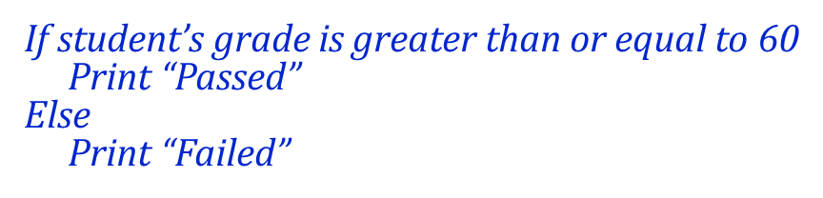
4.6 if…else Double-Selection Statement (1 of 3)
if…else double-selection statement
specifies an action (or group of actions) to perform when the condition is true and a different action to perform when the condition is false.
Pseudocode that prints “Passed” if the student’s grade is greater than or equal to 60, or “Failed” otherwise.

Slide 37
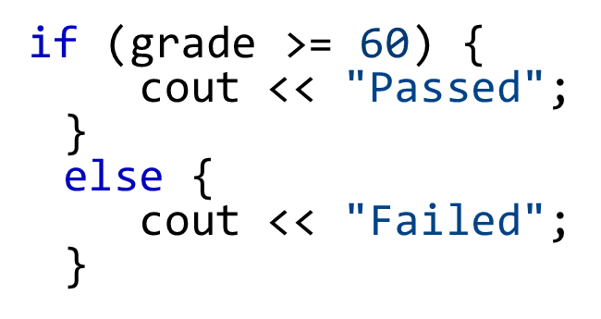
4.6 if…else Double-Selection Statement (2 of 3)
The preceding If…Else pseudocode can be written in C++ as

Slide 38
Good Programming Practice 4.1
Indent both body statements (or groups of statements) of an if…else statement. Many I D Es do this for you.

Slide 39
Good Programming Practice 4.2
If there are several levels of indentation, each level should be indented the same additional amount of space. We prefer three-space indents.

Slide 40
4.6 if…else Double-Selection Statement (3 of 3)
Figure 4.5 illustrates the if…else statement’s flow of control.

Slide 41
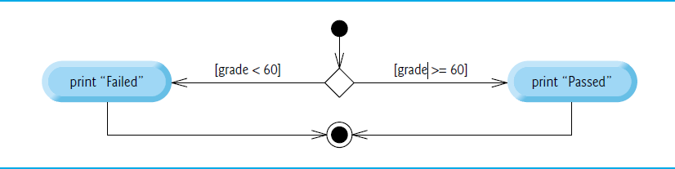
Figure 4.5 If…Else Double-Selection Statement U M L Activity Diagram

Slide 42
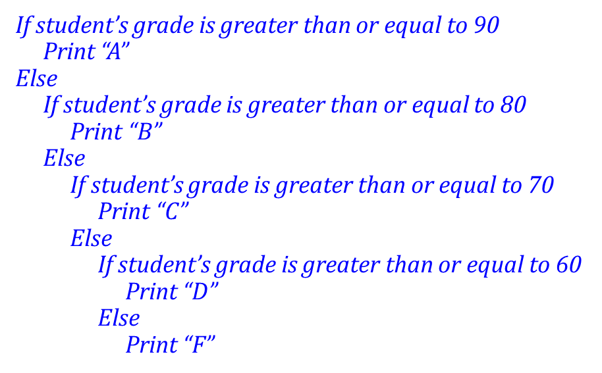
4.6.1 Nested if…else Statements (1 of 5)
Nested if…else statements test for multiple cases by placing if…else selection statements inside other if…else selection statements.

Slide 43
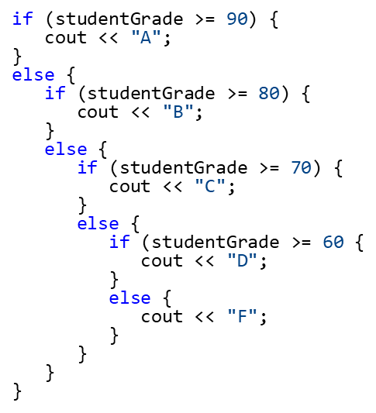
4.6.1 Nested if…else Statements (2 of 5)
This pseudocode can be written in C++ as

Slide 44
4.6.1 Nested if…else Statements (3 of 5)
If variable studentGrade is greater than or equal to 90, the first four conditions in the nested if…else will be true, but only the statement in the if part of the first if…else will execute. After that, the else part of the “outermost” if…else statement is skipped.

Slide 45
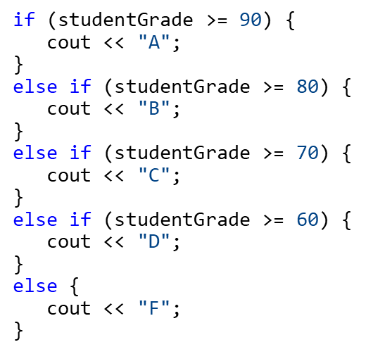
4.6.1 Nested if…else Statements (4 of 5)
Most programmers write the preceding statement as

Slide 46
4.6.1 Nested if…else Statements (5 of 5)
The two forms are identical except for the spacing and indentation, which the compiler ignores.
The latter form is popular because it avoids deep indentation of the code to the right, which can force lines to wrap.

Slide 47
Error-Prevention Tip 4.1
In a nested if…else statement, ensure that you test for all possible cases.

Slide 48
4.6.2 Dangling-Else Problem
Throughout the text, we always enclose control statement bodies in braces ({ and }).
This avoids a logic error called the “dangling-else” problem.
We investigate this problem in Exercises 4.23–4.25.

Slide 49
4.6.3 Blocks (1 of 3)
The if statement normally expects only one statement in its body.
To include several statements in an if (or the body of an else for an if…else statement), enclose the statements in braces.
Good practice to always use the braces.
Statements contained in a pair of braces form a block.
A block can be placed anywhere in a function that a single statement can be placed.

Slide 50
4.6.3 Blocks (2 of 3)
Syntax errors (such as when one brace in a block is left out of the program) are caught by the compiler.
A logic error (such as an incorrect calculation) has its effect at execution time.
A fatal logic error causes a program to fail and terminate prematurely.
A nonfatal logic error allows a program to continue executing but causes it to produce incorrect results.

Slide 51
4.6.3 Blocks (3 of 3)
Just as a block can be placed anywhere a single statement can be placed, it’s also possible to have no statement at all—called a null statement (or an empty statement).
The null state-ment is represented by placing a semicolon (;) where a statement would normally be.

Slide 52
Common Programming Error 4.1
Placing a semicolon after the parenthesized condition in an if or if…else statement leads to a logic error in single-selection if statements and a syntax error in double-selection if…else statements (when the if-part contains a body statement).

Slide 53
4.6.4 Conditional Operator (?:)
Conditional operator (?:)
Closely related to the if…else statement.
C++’s only ternary operator—it takes three operands.
The operands, together with the conditional operator, form a conditional expression.
The first operand is a condition
The second operand is the value for the entire conditional expression if the condition is true
The third operand is the value for the entire conditional expression if the condition is false.
The “values” also can be actions to execute.

Slide 54
4.7 Student Class: Nested if…else Statements (1 of 2)
The example of Figures 4.6–4.7 demonstrates a nested if…else statement that determines a student’s letter grade based on the student’s average in a course.
Class Student (Figure 4.6) stores a student’s name and average and provides member functions for manipulating these values.
Data member name of type string (line 65) to store a Student’s name.
Data member average of type int (line 66) to store a Student’s average in a course.

Slide 55
4.7 Student Class: Nested if…else Statements (2 of 2)
A constructor (lines 8–13) that initializes the name and average.
Member functions setName and getName (lines 16–23) to set and get name.
Member functions setAverage and getAverage (lines 26–39) to set and get average.
Member function getLetterGrade (lines 42–63), which uses nested if…else statements to determine the Student’s letter grade based on the Student’s average.

Slide 56
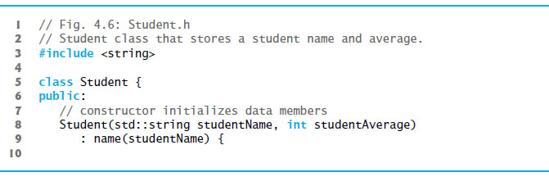
Figure 4.6 Student Class That Stores a Student Name and Average (1 of 4)

Slide 57
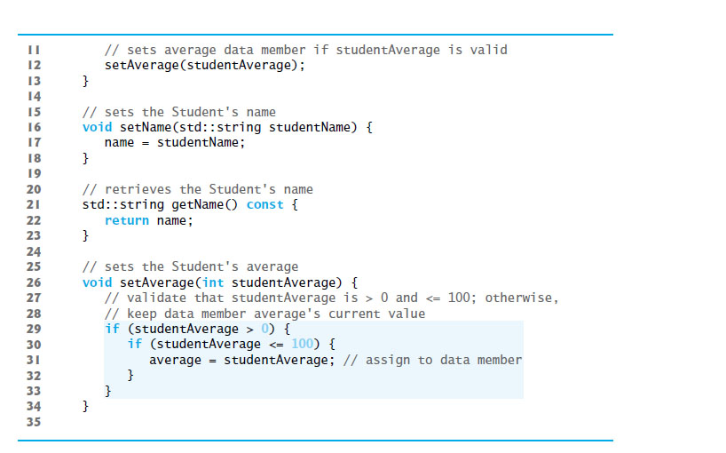
Figure 4.6 Student Class That Stores a Student Name and Average (2 of 4)

Slide 58
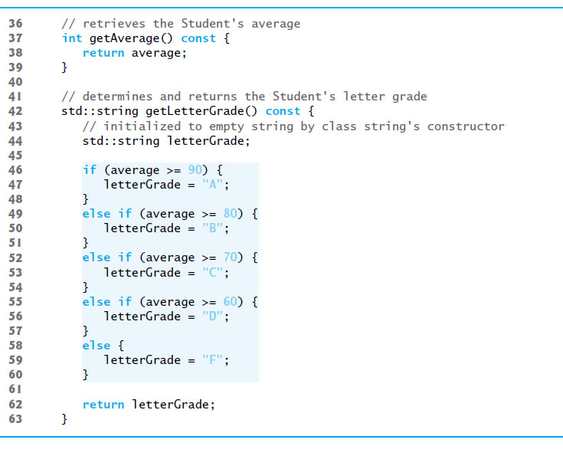
Figure 4.6 Student Class That Stores a Student Name and Average (3 of 4)

Slide 59
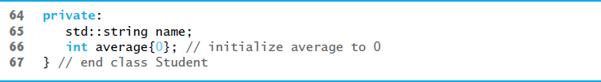
Figure 4.6 Student Class That Stores a Student Name and Average (4 of 4)

Slide 60
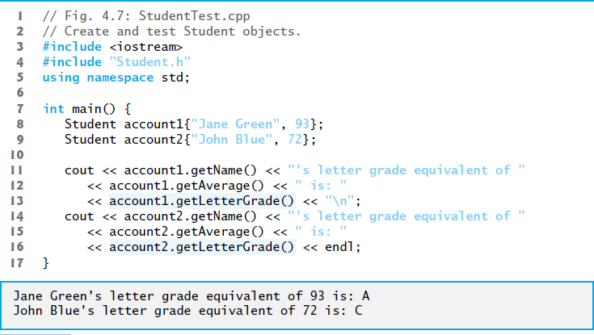
Figure 4.7 Create and Test Student Objects

Slide 61
4.8 while Iteration Statement (1 of 4)
An iteration statement (also called a looping statement or a loop) allows you to specify that a program should repeat an action while some condition remains true.
While there are more items on my shopping list Purchase next item and cross it off my list
“There are more items on my shopping list” is true or false.
If true, “Purchase next item and cross it off my list” is performed.
Performed repeatedly while the condition remains true.
The statement contained in the While iteration statement constitutes the body of the While
Eventually, the condition will become false, the iteration will terminate, and the first pseudocode statement after the iteration statement will execute.

Slide 62
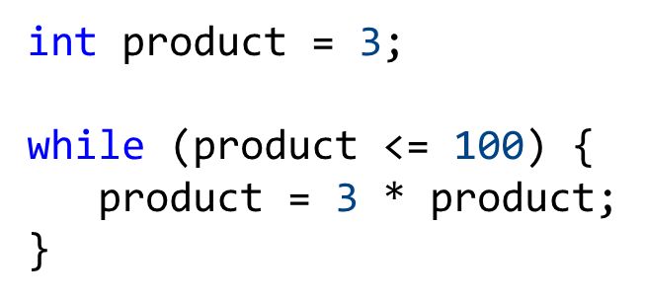
4.8 while Iteration Statement (2 of 4)
Consider a program segment that finds the first power of 3 larger than 100. When the following while iteration statement finishes executing, product contains the result:

Slide 63
Common Programming Error 4.2
Not providing in the body of a while statement an action that eventually causes the condition in the while to become false results in a logic error called an infinite loop (the loop never terminates).

Slide 64
4.8 while Iteration Statement (3 of 4)
The U M L activity diagram of Figure 4.8 illustrates the flow of control that corresponds to the preceding while statement.
Introduces the U M L ’ s merge symbol, which joins two flows of activity into one flow of activity.
The U M L represents both the merge symbol and the decision symbol as diamonds.
The merge symbol joins the transitions from the initial state and from the action state, so they both flow into the decision that determines whether the loop should begin (or continue) executing.

Slide 65
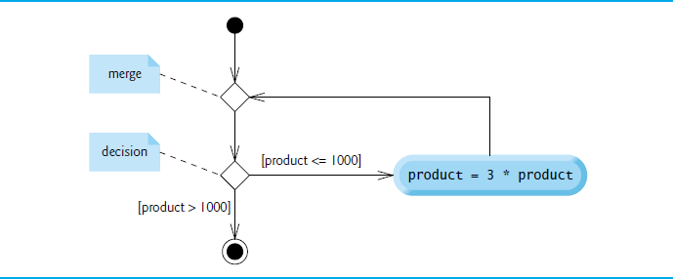
Figure 4.8 while Iteration Statement U M L Activity Diagram

Slide 66
4.8 while Iteration Statement (4 of 4)
The decision and merge symbols can be distinguished by the number of “incoming” and “outgoing” transition arrows.
A decision symbol has one transition arrow pointing to the diamond and two or more transition arrows pointing out from the diamond to indicate possible transitions from that point.
Each transition arrow has a guard condition next to it.
A merge symbol has two or more transition arrows pointing to the diamond and only one transition arrow pointing from the diamond, to indicate multiple activity flows merging to continue the activity.
Unlike the decision symbol, the merge symbol does not have a counterpart in C++ code.

Slide 67
4.9 Formulating Algorithms: Counter-Controlled Iteration
Consider the following problem statement:
A class of ten students took a quiz. The grades (integers in the range 0-100) for this quiz are available to you. Determine the class average on the quiz.
The class average is equal to the sum of the grades divided by the number of students.
The algorithm for solving this problem on a computer must input each grade, keep track of the total of all grades entered, perform the averaging calculation and print the result.

Slide 68
4.9.1 Pseudocode Algorithm with Counter Controlled Iteration (1 of 2)
We use counter-controlled iteration to input the grades one at a time.
This technique uses a variable called a counter (or control variable) to control the number of times a group of statements will execute.
Often called definite iteration because the number of iterations is known before the loop begins executing.

Slide 69
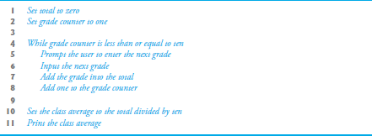
Figure 4.9 Pseudocode Algorithm That Uses Counter-Controlled Iteration to Solve the Class-Average Problem

Slide 70
4.9.1 Pseudocode Algorithm with Counter Controlled Iteration (2 of 2)
A total is a variable used to accumulate the sum of several values.
A counter is a variable used to count—in this case, the grade counter indicates which of the 10 grades is about to be entered by the user.
Variables that are used to store totals are normally initialized to zero before being used in a program; otherwise, the sum would include the previous value stored in the total’s memory location.

Slide 71
Software Engineering Observation 4.1
Experience has shown that the most difficult part of solving a problem on a computer is developing the algorithm for the solution. Once a correct algorithm has been specified, producing a working C++ program from it is usually straightforward.

Slide 72
4.9.2 Implementing Counter-Controlled Iteration (1 of 4)
Figure 4.10 implements the class-average problem using counter-controlled iteration.

Slide 73
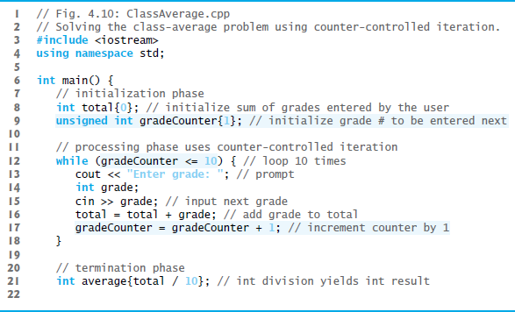
Figure 4.10 Solving the Class-Average Problem Using Counter-Controlled Iteration (1 of 2)

Slide 74
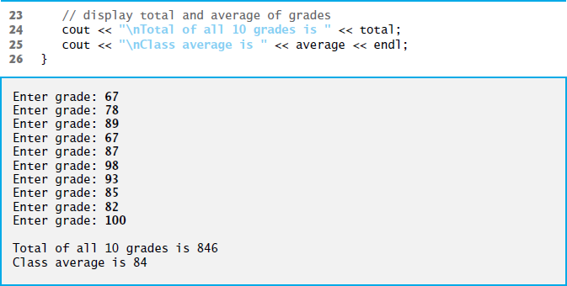
Figure 4.10 Solving the Class-Average Problem Using Counter-Controlled Iteration (2 of 2)

Slide 75
4.9.2 Implementing Counter-Controlled Iteration (2 of 4)
Variable gradeCounter is of type unsigned int, because it can assume only the values from 1 through 11 (11 terminates the loop), which are all positive values.
In general, counters that should store only nonnegative values should be declared with unsigned types.
Variables of unsigned integer types can represent values from 0 to approximately twice the positive range of the corresponding signed integer types.

Slide 76
4.9.2 Implementing Counter-Controlled Iteration (3 of 4)
A variable declared in a function body is a local variable and can be used only from the line of its declaration to the closing right brace of the block in which the variable is declared.
A local variable’s declaration must appear before the variable is used; otherwise, a compilation error occurs.
Variable grade—declared in the body of the while loop—can be used only in that block.

Slide 77
4.9.2 Implementing Counter-Controlled Iteration (4 of 4)
You’ll normally initialize counter variables to zero or one, depending on how they are used in an algorithm.

Slide 78
Error-Prevention Tip 4.2
Initialize each total and counter, either in its declaration or in an assignment statement. Totals are normally initialized to 0. Counters are normally initialized to 0 or 1, depending on how they’re used (we’ll show examples of when to use 0 and when to use 1).

Slide 79
4.9.3 Notes on Integer Division and Truncation
Dividing two integers results in integer division—any fractional part of the calculation is truncated (discarded).

Slide 80
Common Programming Error 4.3
Assuming that integer division rounds (rather than truncates) can lead to incorrect results. For example, 7 ÷ 4, which yields 1.75 in conventional arithmetic, truncates to 1 in integer arithmetic, rather than rounding to 2.

Slide 81
4.9.3 Arithmetic Overflow (1 of 3)
In Figure 4.10, line 16
total = total + grade; // add grade to total
added each grade entered by the user to the total.
Even this simple statement has a potential problem—adding the integers could result in a value that’s too large to store in an int variable.
This is known as arithmetic overflow and causes undefined behavior, which can lead to security problems or unintended results
http://en.wikipedia.org/wiki/Integer_overflow #Security_ramifications

Slide 82
4.9.3 Arithmetic Overflow (2 of 3)
Figure 2.5’s addition program had the same issue in line 19, which calculated the sum of two int values entered by the user:
sum = number1 + number2;
The maximum and minimum values that can be stored in an int variable are represented by the constants INT_MAX and INT_MIN, respectively, which are defined in the header <climits>.

Slide 83
4.9.3 Arithmetic Overflow (3 of 3)
There are similar constants for the other integral types and for floating-point types.
You can see your platform’s values for these constants by opening the headers <climits> and <cfloat> in a text editor.
It’s considered a good practice to ensure that before you perform arithmetic calculations like the ones in line 16 of Figure 4.10 and line 19 of Figure 2.5, they will not overflow.
The code for doing this is shown on the C E R T website www.securecoding.cert.org—just search for guideline “INT32-CPP.” (Uses operators defined in next chapter.)

Slide 84
4.9.4 Input Validation
To ensure that inputs are valid, industrial-strength programs must test for all possible erroneous cases.
A program that inputs grades should validate the grades by using range checking to ensure that they’re values from 0 to 100.
You can then ask the user to reenter any value that’s out of range.
If a program requires inputs from a specific set of values (e.g., nonsequential product codes), you can ensure that each input matches a value in the set.

Slide 85
4.10 Formulating Algorithms: Sentinel-Controlled Iteration
Let’s generalize the class average problem.
Develop a class average program that processes grades for an arbitrary number of students each time it’s run.
Must process an arbitrary number of grades.
How can the program determine when to stop the input?
Sentinel value (also called a signal value, a dummy value or a flag value) can be used for “end of data entry.”
Sentinel-controlled iteration is often called indefinite iteration
the number of iterations is not known in advance.
Sentinel value must not be an acceptable input value.

Slide 86
4.10.1 Top-Down, Stepwise Refinement: the Top and First Refinement (1 of 2)
We approach the class average program with a technique called top-down, stepwise refinement
Begin with a pseudocode representation of the top—a single statement that conveys program’s overall function
Determine the class average for the quiz for an arbitrary number of students
The top is, in effect, a complete representation of a program.
Rarely conveys sufficient detail from which to write a pro-gram.

Slide 87
4.10.1 Top-Down, Stepwise Refinement: the Top and First Refinement (2 of 2)
We divide the top into a series of smaller tasks and list these in the order in which they need to be performed.
This results in the following first refinement.
Initialize variables
Input, sum and count the quiz grades
Calculate and print the class average
This refinement uses only the sequence structure—these steps execute in order.

Slide 88
Software Engineering Observation 4.2
Each refinement, as well as the top itself, is a complete specification of the algorithm—only the level of detail varies.

Slide 89
4.10.2 Proceeding to the Second Refinement (1 of 4)
In the second refinement, we commit to specific variables.
The pseudocode statement
Input, sum and count the quiz grades
requires an iteration statement (i.e., a loop) that successively inputs each grade.

Slide 90
4.10.2 Proceeding to the Second Refinement (2 of 4)
We don’t know in advance how many grades are to be processed, so we’ll use sentinel-controlled iteration.
The user enters legitimate grades one at a time.
After entering the last legitimate grade, the user enters the sentinel value.
The program tests for the sentinel value after each grade is input and terminates the loop when the user enters the sentinel value.

Slide 91
4.10.2 Proceeding to the Second Refinement (3 of 4)
The second refinement of the preceding pseudocode statement is then
Prompt the user to enter the first grade
Input the first grade (possibly the sentinel)
While the user has not yet entered the sentinel
Add this grade into the running total
Add one to the grade counter
Prompt the user to enter the next grade
Input the next grade (possibly the sentinel)

Slide 92
4.10.2 Proceeding to the Second Refinement (4 of 4)
The pseudocode statement
Calculate and print the total of all student grades and the class average
can be refined as follows:
If the counter is not equal to zero
Set the average to the total divided by the counter
Print the average
else
Print “No grades were entered”
Test for the possibility of division by zero
Normally a fatal logic error that, if undetected, would cause the program to fail (often called “crashing”).

Slide 93
Error-Prevention Tip 4.3
According to the C++ standard, the result of division by zero in floating-point arithmetic is undefined. When performing division (/) or remainder (%) calculations in which the right operand could be zero, test for this and handle it (e.g., display an error message) rather than allowing the calculation to proceed.

Slide 94
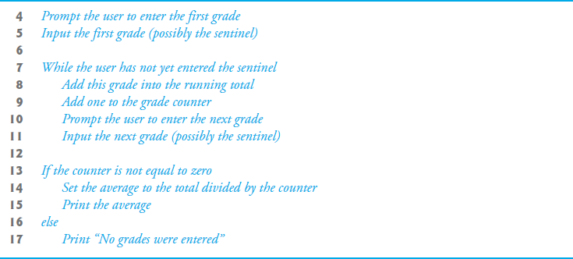
Figure 4.11: Class-Averaging Pseudocode Algorithm with Sentinel-Controlled Iteration

Slide 95
Software Engineering Observation 4.3
Terminate the top-down, stepwise refinement process when you’ve specified the pseudocode algorithm in sufficient detail for you to convert the pseudocode to C++.

Slide 96
Software Engineering Observation 4.4
Some programmers do not use program development tools like pseudocode. They feel that their ultimate goal is to solve the problem on a computer and that writing pseudocode merely delays the production of final outputs. Although this may work for simple and familiar problems, it can lead to serious errors and delays in large, complex projects.

Slide 97
4.10.3 Implementing Sentinel-Controlled Iteration (1 of 2)
An averaging calculation is likely to produce a number with a decimal point—a real number or floating-point number (e.g., 7.33, 0.0975 or 1000.12345).
Type int cannot represent such a number.
C++ provides several data types for storing floating-point numbers in memory, including float and double.
Compared to float variables, double variables can typically store numbers with larger magnitude and finer detail
more digits to the right of the decimal point—also known as the number’s precision.
Cast operator can be used to force the averaging calculation to produce a floating-point numeric result.

Slide 98
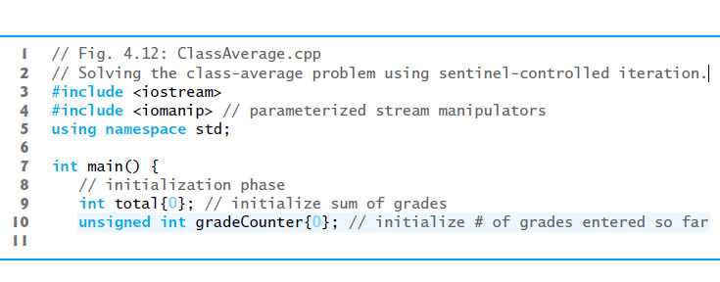
Figure 4.12: Solving the Class-Average Problem Using Sentinel-Controlled Iteration (1 of 4)

Slide 99
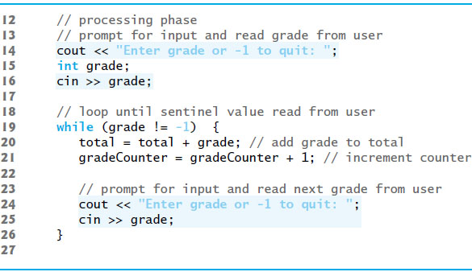
Figure 4.12: Solving the Class-Average Problem Using Sentinel-Controlled Iteration (2 of 4)

Slide 100
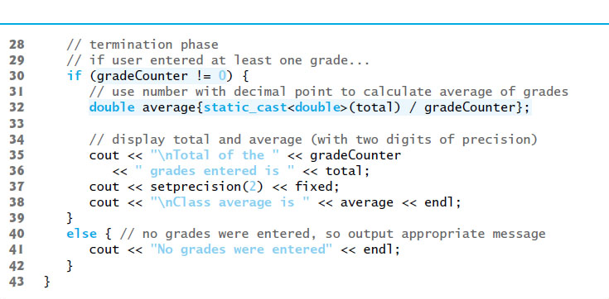
Figure 4.12: Solving the Class-Average Problem Using Sentinel-Controlled Iteration (3 of 4)

Slide 101
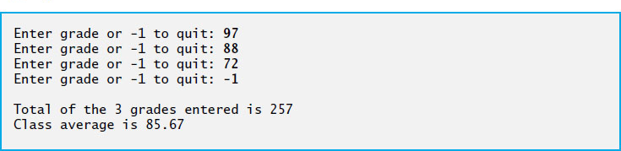
Figure 4.12: Solving the Class-Average Problem Using Sentinel-Controlled Iteration (4 of 4)

Slide 102
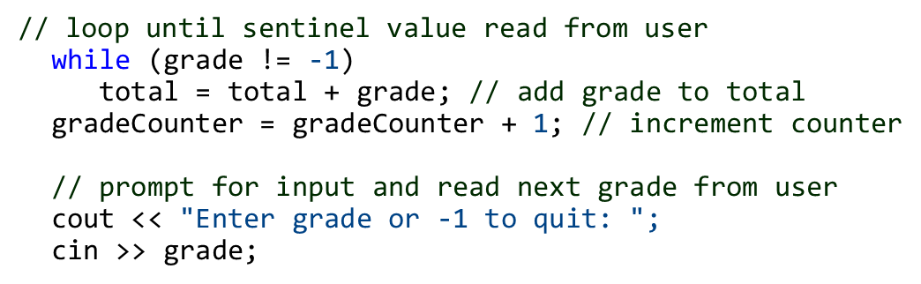
4.10.3 Implementing Sentinel-Controlled Iteration (2 of 2)
Notice the block in the while loop.
Without the braces, the last three statements in the loop would fall outside its body, as follows:
Would cause an infinite loop in the program if the user did not input −1 for the first grade.

Slide 103
4.10.4 Converting between Fundamental Types Explicitly and Implicitly (1 of 3)
The variable average is declared to be of type double to capture the fractional result of our calculation.
total and gradeCounter are both integer variables.
Recall that dividing two integers results in integer division, in which any fractional part of the calculation is lost (i.e., truncated).
In the following statement the division occurs first—the result’s fractional part is lost before it’s assigned to average:

Slide 104
4.10.4 Converting between Fundamental Types Explicitly and Implicitly (2 of 3)
To perform a floating-point calculation with integers, create temporary floating-point values.
static_cast operator accomplishes this task.
The cast operator static_cast<double>(total) creates a temporary floating-point copy of its operand in parentheses.
Known as explicit conversion.
The value stored in total is still an integer.

Slide 105
4.10.4 Converting between Fundamental Types Explicitly and Implicitly (3 of 3)
The calculation now consists of a floating-point value divided by the integer gradeCounter.
The compiler knows how to evaluate only expressions in which the operand types of are identical.
Compiler performs promotion (also called implicit conversion) on selected operands.
In an expression containing values of data types int and double, C++ promotes int operands to double values.
Cast operators are available for use with every data type and with class types as well.

Slide 106
Good Programming Practice 4.3
In a sentinel-controlled loop, prompts should remind the user of the sentinel.

Slide 107
4.10.5 Formatting Floating-Point Numbers (1 of 3)
The call to setprecision (with an argument of 2) indicates that double values should be printed with two digits of precision to the right of the decimal point (e.g., 92.37).
Parameterized stream manipulator (argument in parentheses).
Programs that use these must include the header <iomanip>.
endl is a nonparameterized stream manipulator and does not require the <iomanip> header file.
If the precision is not specified, floating-point values are normally output with six digits of precision.

Slide 108
4.10.5 Formatting Floating-Point Numbers (2 of 3)
Stream manipulator fixed indicates that floating-point values should be output in fixed-point format, as opposed to scientific notation.
Fixed-point formatting is used to force a floating-point number to display a specific number of digits.
Specifying fixed-point formatting also forces the decimal point and trailing zeros to print, even if the value is a whole number amount, such as 88.00.
Without the fixed-point formatting option, such a value prints in C++ as 88 without the trailing zeros and decimal point.

Slide 109
4.10.5 Formatting Floating-Point Numbers (3 of 3)
When the stream manipulators fixed and setprecision are used in a program, the printed value is rounded to the number of decimal positions indicated by the value passed to setprecision (e.g., the value 2), although the value in memory re-mains unaltered.
It’s also possible to force a decimal point to appear by using stream manipulator showpoint.
If showpoint is specified without fixed, then trailing zeros will not print.
Both can be found in header <iostream>.

Slide 110
4.10.6 Unsigned Integers and User Input (1 of 2)
Figure 4.10 declared the variable gradeCounter as an unsigned int because it can assume only the values from 1 through 11 (11 terminates the loop), which are all non-negative values.
Could have also declared as unsigned int the variables grade, total and average. Grades are normally values from 0 to 100, so the total and average should each be greater than or equal to 0.
We declared those variables as ints because we can’t control what the user actually enters—the user could enter negative values.
Worse yet, the user could enter a value that’s not even a number.

Slide 111
4.10.6 Unsigned Integers and User Input (2 of 2)
Sometimes sentinel-controlled loops use intentionally invalid values to terminate a loop.
We terminate the loop when the user enters the sentinel -1 (an invalid grade), so it would be improper to declare variable grade as an unsigned int.
As you’ll see, the end-of-file (E O F) indicator is also normally implemented internally in the compiler as a negative number.

Slide 112
4.11 Formulating Algorithms: Nested Control Statements
For the next example, we once again formulate an algorithm by using pseudocode and top-down, stepwise refinement, and write a corresponding C++ program.
In this case study, we examine the only other structured way control statements can be connected—namely, by nesting one control statement within another.

Slide 113
4.11.1 Problem Statement (1 of 3)
Consider the following problem statement:
A college offers a course that prepares students for the state licensing exam for real es-tate brokers. Last year, ten of the students who completed this course took the exam. The college wants to know how well its students did on the exam. You’ve been asked to write a program to summarize the results. You’ve been given a list of these 10 students. Next to each name is written a 1 if the student passed the exam or a 2 if the student failed.

Slide 114
4.11.1 Problem Statement (2 of 3)
Your program should analyze the results of the exam as follows:
Input each test result (i.e., a 1 or a 2). Display the prompting message “Enter result” on the screen each time the program requests another test result.
Count the number of test results of each type.
Display a summary of the test results indicating the number of students who passed and the number who failed.
If more than eight students passed the exam, print “Bonus to instructor!”

Slide 115
4.11.1 Problem Statement (3 of 3)
After reading the problem statement carefully, we make the following observations:
Must process test results for 10 students. A counter-controlled loop can be used because the number of test results is known in advance.
Each test result is either a 1 or a 2. Each time the program reads a test result, the program must determine whether the number is a 1 or a 2. For simplicity, we test only for a 1 in our algorithm. If the number is not a 1, we assume that it’s a 2.
Two counters keep track of the exam results—one to count the number of students who passed and one to count the number of students who failed.
After the program has processed all the results, it must decide whether more than eight students passed the exam.

Slide 116
4.11.2 Top-Down Stepwise Refinement: Pseudocode Representation of the Top
Pseudocode representation of the top:
Analyze exam results and decide whether tuition should be raised

Slide 117
4.11.3 Top-Down Stepwise Refinement: First Refinement
First refinement
Initialize variables
Input the 10 exam results, and count passes and failures
Print a summary of the exam results and decide whether a bonus should be paid
Further refinement is necessary.
Counters are needed to record the passes and failures, a counter will be used to control the looping process and a variable is needed to store the user input.

Slide 118
4.11.4 Top-Down Stepwise Refinement: Second Refinement (1 of 4)
The pseudocode statement
Initialize variables
can be refined as follows:
Initialize passes to zero
Initialize failures to zero
Initialize student counter to one

Slide 119
4.11.4 Top-Down Stepwise Refinement: Second Refinement (2 of 4)
The following pseudocode statement requires a loop that successively inputs the result of each exam
Input the 10 exam results, and count passes and failures
10 exam results, so counter-controlled looping is appropriate.
Nested inside the loop, an if…else statement will determine whether each exam result is a pass or a failure and will increment the appropriate counter.

Slide 120
4.11.4 Top-Down Stepwise Refinement: Second Refinement (3 of 4)
The refinement of the preceding pseudocode statement is then
While student counter is less than or equal to 10
Prompt the user to enter the next exam result
Input the next exam result
If the student passed
Add one to passes
Else
Add one to failures
Add one to student counter

Slide 121
4.11.4 Top-Down Stepwise Refinement: Second Refinement (4 of 4)
The pseudocode statement
Print a summary of the exam results and decide whether bonus should be paid
can be refined as follows:
Print the number of passes
Print the number of failures
If more than eight students passed
Print “Bonus to instructor!”
The complete second refinement appears in Figure 4.13.

Slide 122
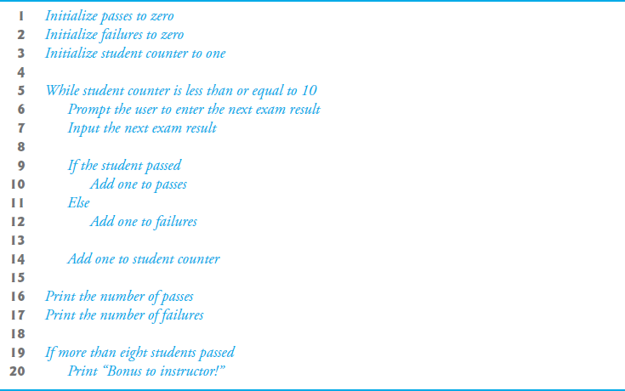
Figure 4.13 Pseudocode for Examination-Results Problem

Slide 123
4.11.6 Program That Implements the Pseudocode Algoritm (1 of 2)
The program that implements the pseudocode algorithm and two sample executions are shown in Figure 4.14.

Slide 124
Error-Prevention Tip 4.4
Initializing local variables when they’re declared helps you avoid any compilation warnings that might arise from attempts to use uninitialized variables and helps you avoid logic errors from using uninitialized variables.

Slide 125
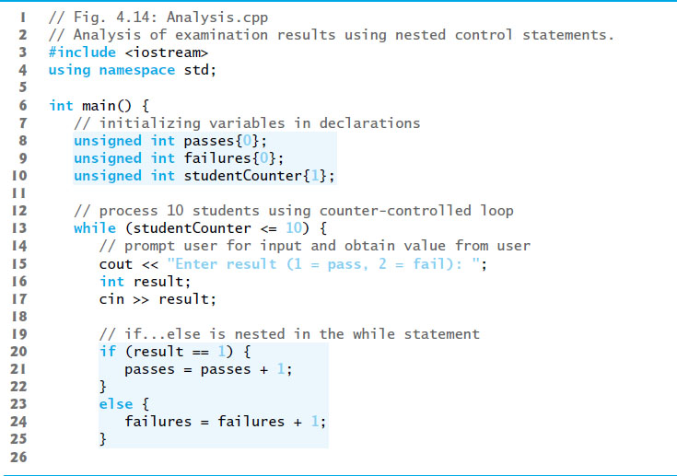
Figure 4.14 Analysis of Examination Results Using Nested Control Statements (1 of 3)

Slide 126
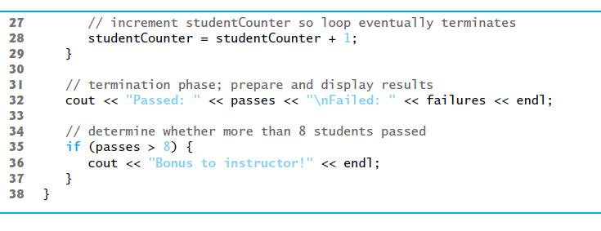
Figure 4.14 Analysis of Examination Results Using Nested Control Statements (2 of 3)

Slide 127
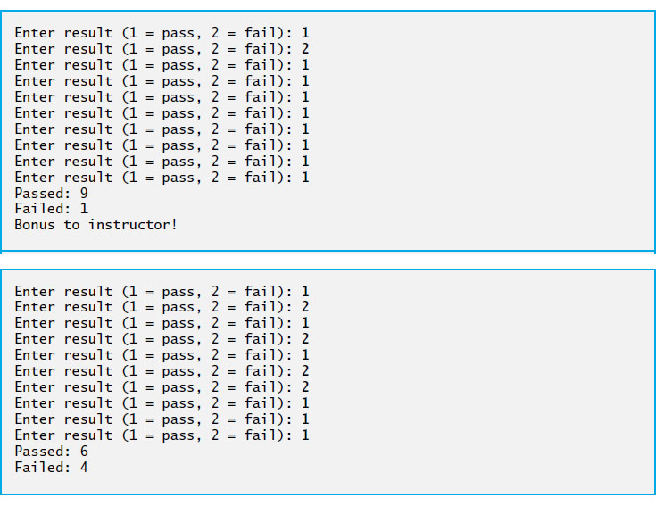
Figure 4.14 Analysis of Examination Results Using Nested Control Statements (3 of 3)

Slide 128
4.11.6 Program That Implements the Pseudocode Algoritm (2 of 2)
The if…else statement for processing each result is nested in the while statement.
The if statement after the loop determines whether more than eight students passed the exam and, if so, outputs the message "Bonus to instructor!".

Slide 129
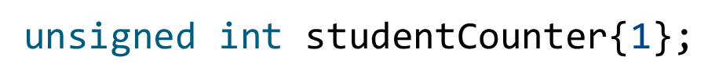
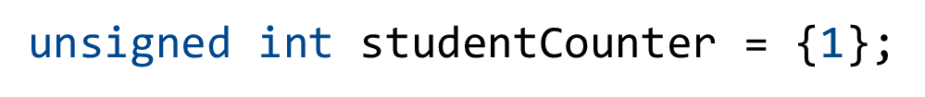

4.11.7 Preventing Narrowing Conversions with List Initialization (1 of 3)
Consider from Figure 4.14
Can also write as
or

Slide 130
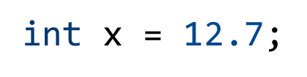
4.11.7 Preventing Narrowing Conversions with List Initialization (2 of 3)
For fundamental-type variables, list-initialization syntax also prevents so-called narrowing conversions that could result in data loss.
For example, previously you could write
which attempts to assign the double value 12.7 to the int variable x.
A double value is converted to an int, by truncating the floating-point part (.7), which results in a loss of information—a narrowing conversion.

Slide 131


4.11.7 Preventing Narrowing Conversions with List Initialization (3 of 3)
The actual value assigned to x is 12.
Many compilers generate a warning for this statement, but still allow it to compile.
However, using list initialization, as in
or
yields a compilation error.

Slide 132
4.12 Compund Assignment Operators
The compound assignment operators abbreviate assignment expressions.
The += operator adds the value of the expression on the right of the operator to the value of the variable on the left of the operator and stores the result in the variable on the left of the operator.
Any statement of the form
variable = variable operator expression;
in which the same variable appears on both sides of the assignment operator and operator is one of the binary operators
(or others we’ll discuss later in the text), can be written in the form
variable operator= expression;
Thus the assignment c += 3 adds 3 to c.
Figure 4.15 shows the arithmetic assignment operators, sample expressions using these operators and explanations.

Slide 133
Figure 4.15 Arithmetic Compound Assignment Operators
Assume: int c = 3, d = 5, e = 4, f = 6, g = 12;
Assignment operator | Sample expression | Explanation | Assigns
Plus equals | c plus equals 7 | c equals c plus 7 | 10 to c
Minus equals | d minus equals 4 | d equals d minus 4 | 1 to d
Asterisk equals | e asterisk equals 5 | e equals e asterisk 5 | 20 to e
Forward slash equals | f forward slash equals 3 | f equals f forward slash 3 | 2 to f
Percent sign equals | g percent equals 9 | g equals g percent 9 | 3 to g

Slide 134
4.13 Increment and Decrement Operators (1 of 3)
C++ also provides two unary operators for adding 1 to or subtracting 1 from the value of a numeric variable.
These are the unary increment operator,
and the
Unary decrement operator,
which are summarized
in Figure 4.16.

Slide 135
Figure 4.16 Increment and decrement operators
Operator | Operator name | Sample expression | Explanation
Plus plus | Prefix increment | Plus plus a | Increment a by 1, then use the new value of a in the expression in which a resides.
Plus plus | postfix increment | a plus plus | Use the current value of a in the expression in which a resides, then increment a by 1.
Minus minus | Prefix decrement | Plus plus b | Decrement b by 1, then use the new value of b in the expression in which b resides.
Minus minus | postfix decrement | b plus plus | Use the current value of b in the expression in which b resides, then decrement b by 1.

Slide 136
Good Programming Practice 4.4
Unlike binary operators, the unary increment and decrement operators as a matter of style should be placed next to their operands, with no intervening spaces.

Slide 137
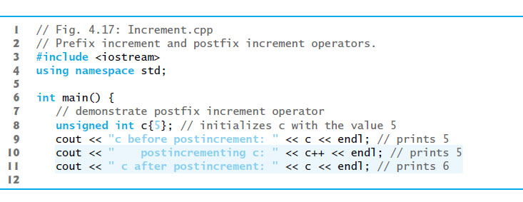
Figure 4.17 Prefix Increment and Postfix Increment Operators (1 of 2)

Slide 138
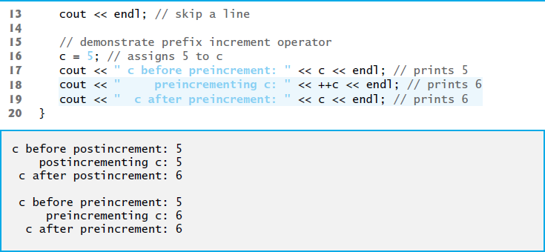
Figure 4.17 Prefix Increment and Postfix Increment Operators (2 of 2)

Slide 139
4.13 Increment and Decrement Operators (2 of 3)
When you
variable in a statement by itself, the preincrement and postincrement forms have the same effect, and the predecrement and postdecrement forms have the same effect.
In the context of a larger expression preincrementing a variable and postincrementing a variable have different effects (and similarly for predecrementing and post-decrementing).

Slide 140
Common Programming Error 4.4
Attempting to use the increment or decrement operator on an expression other than one to which a value can be assigned is a syntax error. For example, writing
is a syntax error, because (x + 1) is not a variable.

Slide 141
4.13 Increment and Decrement Operators (3 of 3)
Figure 4.18 shows the precedence and associativity of the operators introduced to this point.

Slide 142
Good Programming Practice 4.5
Refer to the operator precedence and associativity chart (Appendix A) when writing expressions containing many operators. Confirm that the operators in the expression are performed in the order you expect. If you’re uncertain about the order of evaluation in a complex expression, break the expression into smaller statements or use parentheses to force the order of evaluation, exactly as you’d do in an algebraic expression. Be sure to observe that some operators such as assignment (=) associate right to left rather than left to right.

Slide 143
Figure 4.18 Operator Precedence for the Operators Encountered So Far in the Text
Operators | Associativity | Type
colon colon left parenthesis right parenthesis | left to right [See Figure 2.10’s caution regarding grouping parentheses.] | primary
plus plus minus minus static underscore cast left angle bracket type right angle bracket left parenthesis right parenthesis | left to right | postfix
plus plus minus minus plus minus | right to left | unary (prefix)
asterisk slash percent sign | left to right | multiplicative
plus minus | left to right | additive
left angle bracket left angle bracket right angle bracket right angle bracket | left to right | insertion/extraction
left angle bracket left angle bracket equals equals right angle bracket right angle bracket equals | left to right | relational
equals equals exclamation point equals | left to right | equality
question mark colon | right to left | conditional
equals plus equals minus equals asterisk equals slash equals percent sign equals | right to left | assignment

Slide 144
4.14 Fundamental Types Are Not Portable
The table in Appendix C lists C++’s fundamental types.
C++ requires all variables to have a type.
In C and C++, programmers frequently have to write separate versions of programs to support different computer platforms, because the fundamental types are not guaranteed to be identical from computer to computer.
An int on one machine might be represented by 16 bits (2 bytes) of memory, on a second machine by 32 bits (4 bytes), and on another machine by 64 bits (8 bytes).

Slide 145
Portability Tip 4.2
C++’s fundamental types are not portable across all computer platforms that support C++.

Slide 146

Copyright

